Slide 3
Through the lens of Psychoanalysis
Feminine Spirituality
Power of Prayer consist of individual elements of thought, feeling, emotions.
Heart, Mind and Body
Wisdom
Purity of Intention
Strength
Notes:
Feminism is the advocacy of womens equal rights It is through the strength of a women’s body, the wisdom of our hearts experiences and the purity of our intentions that determine our quality of life.
Feminity is

Slide 4
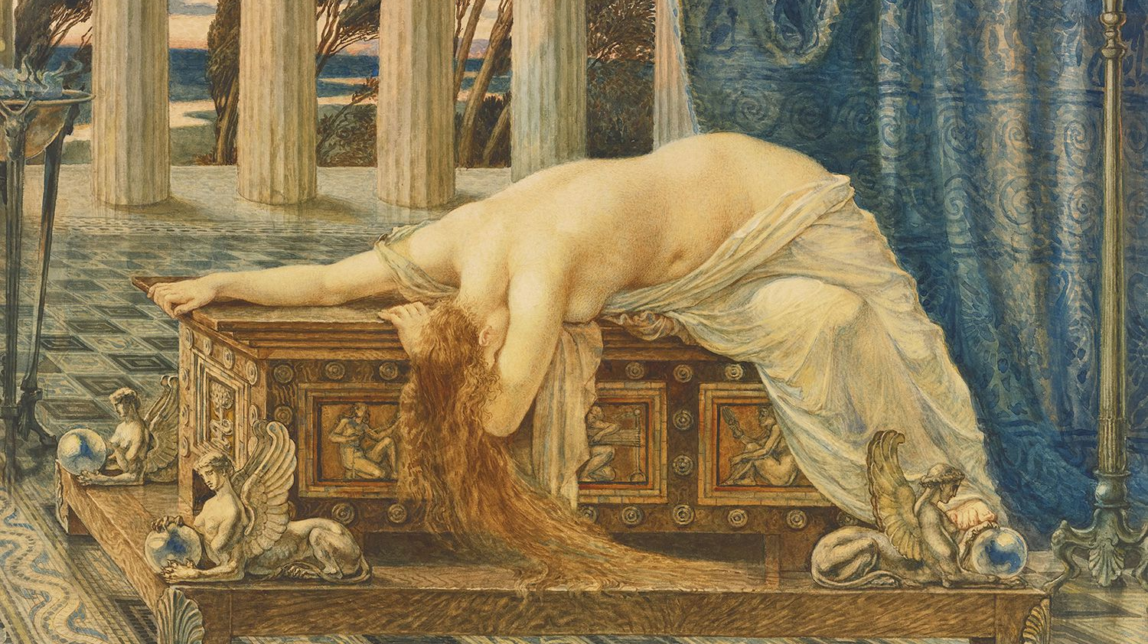
Pandora’s Box
Notes:
What is left in Pandora’s Box is Hope. It is my hope that this presentation will shed some light on the strength, voices and truth of women who seek to be co-creators with Christ in the world.

Slide 5
Alexander Pope- British Poet- (1688-1744)
“Hope Springs Eternal in the Human Breast”
Notes:
Is a woman made or is a woman born? What are the roles of differentiation and what does integration look like? What does a woman want? I raise these questions to hold in mind while exploring what the psychological underpinnings are within feminine spirituality. I will do this through vignettes of women throughout history in hopes of offering a few gems to you.

Slide 6
Mystical and Psychoanalytic Reflections

Slide 7
Hildegard Von Bingen (1098-1179)
“Just as a mirror, which reflects all things, is set in its own container, so too the rational soul is placed in the fragile container of the body. In this way, the body is governed in its earthly life by the soul, and the soul contemplates heavenly things through faith.” (Hildegard von bingen)
Notes:
Our human brokenness gives rise to divinity- Hildegard Von Bingen (1098-1179)

Slide 8
Freud-1923 Id, Ego and Superego
The depth of human life is lived in the body. The Body is the first Ego

Slide 9
Contemporary Psychoanalysts
Father of Psychoanalysis- Freud
Mother of Psychoanalysis-
Anna Freud, Melanie Klein, Helene Deutsch, Marie Bonaparte and Rosemary Balsam

Slide 10
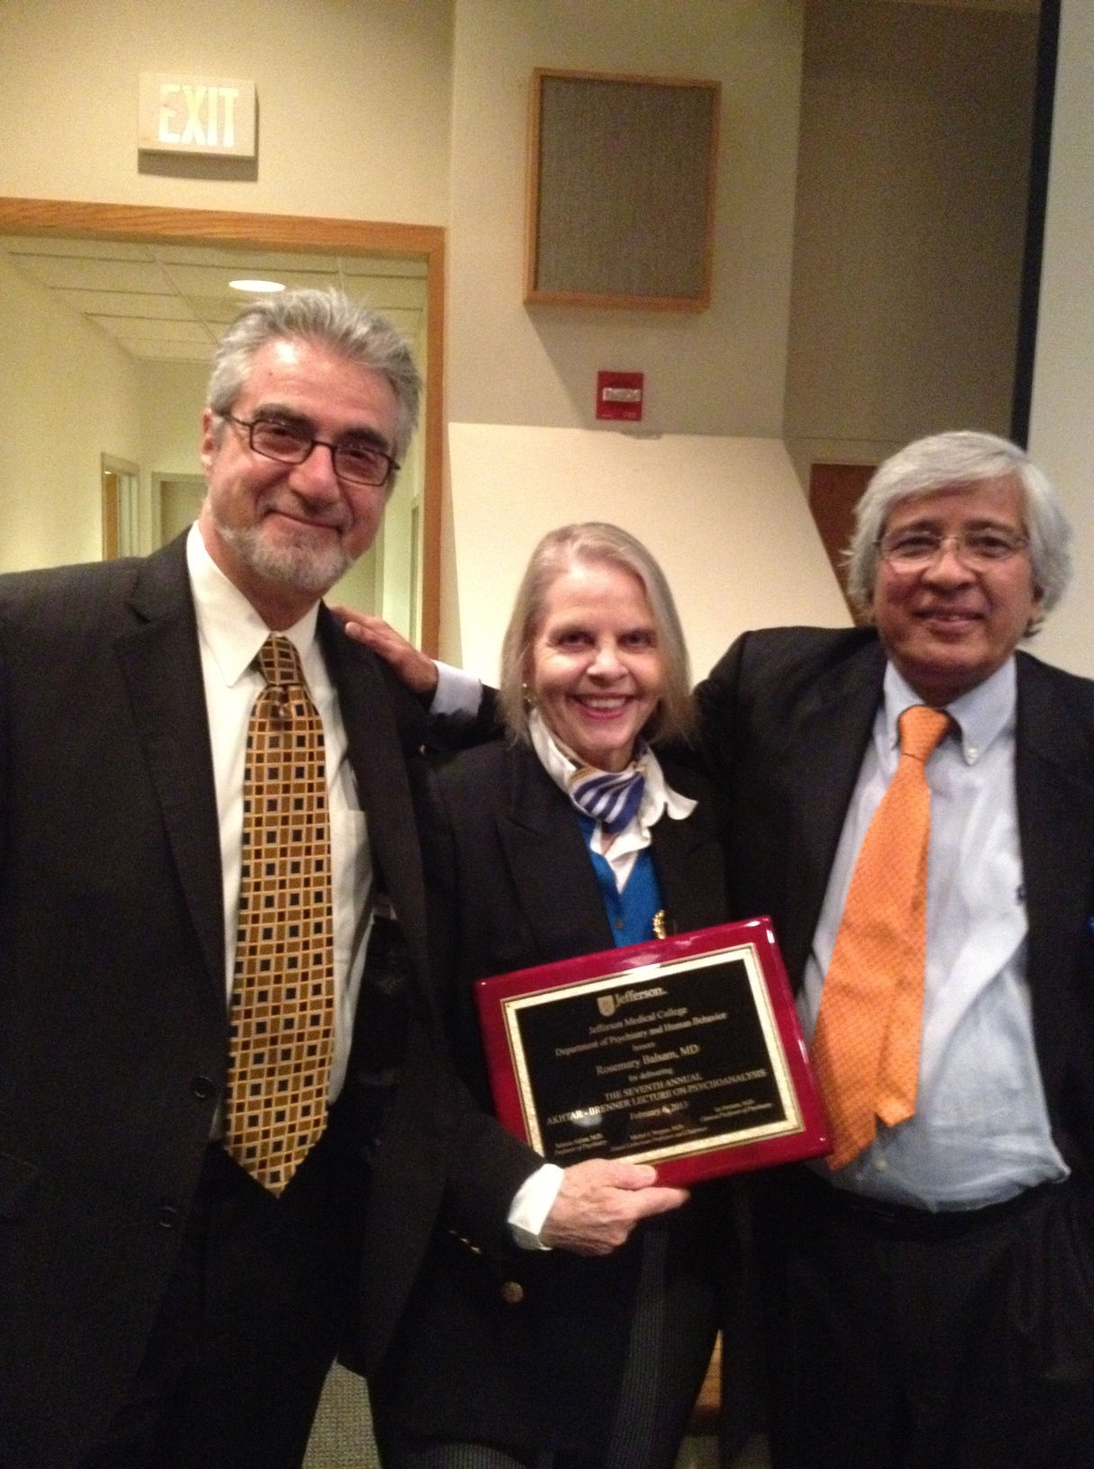
Rosemary Balsam
Life is not lived outside of the body
Stay focused on body through pregnancy and childbirth and to think about body’s contribution to gender.
Women are separate from man, children and being mothers
Notes:
Focus on listening to interior corporeal memories are constantly present in clinical dyad

Slide 11
Role of Female Body
Rosemary Balsam
Pleasure seeking
Pregnancy
Childbirth
Think about the body’s contribution to gender

Slide 12
Role of Female Body
Marie Bonapart
Orgasm
Pleasure for women
Notes:
Expanding gender to sexuality belongs famously to Marie Bonaparte. This photo was taken in 1939.

Slide 13
Hans Loewald (1906-1993)
German- American Psychoanalyst trained as a Freudian but contributed greater to a newer understanding of Feminine development.
Dance of differentiation and integration from birth on
All embracing feeling of intimate connection or unity with the environment

Slide 14
Julian of Norwich (1342-1462)
“our savior is our true mother in whom we are endlessly born and out of whom we shall never come forth.”
She believed God and soul: there was no between
“But for I am a woman I therefore live that I should not tell you the goodness of God.”
Notes:
Visionaries abound within feminine Christian mysticism. Julian of Norwich writes about her vision of Jesus. (1342-1462)

Slide 15
What Do Women Want
To be heard,
To be understood
To be respected
Women have emotional strength
Women see the world differently than men due to their bodies

Slide 16
Women in Early History

Slide 17
Sojourner Truth Born Isabella Baumfree (1797-1883)
Founding mother of the women’s movement

Slide 18
Ain’t I A Woman (1850)
That man over there says that women need to be helped into carriages and lifted over ditches and to have the best place everywhere. Nobody ever helps me into carriages, over mud-puddles or give me any best place! Ain’t I a woman? Look at me! Look at my arm! I have ploughed and planted and gathered into barns and no man could head me! And ain’t I a woman? I could work as much and eat as much-when I could get it-and bear the lash as well! And ain’t I a woman? I have borne thirteen children, and seen most all sold off to slavery, and when I cried out with my mother’s grief, none but Jesus heard me! And ain’t I am woman?

Slide 19
Ain’t I A Woman (1850)
Then that little man in the black there, he says women can’t have as much rights as men, ‘cause Christ wasn’t a woman! Where did Christ come from? Where did your Christ come from? From God and a woman! Man had nothing to do with Him. If the first woman God ever made was strong enough to turn the world upside down all alone, these women together ought to be able to turn it back, and get it right side up again! And now they is asking to do it, the men better let them.”

Slide 20
Mary Wollstonecraft (1759-1797)
Vindication of the Rights of Women
Declared both women and men were human beings endowed with inalienable rights to life, liberty and pursuit of happiness.
She dared to do what no woman of her time had done, pursue a full time professional writing career without an aristocratic male sponsor.

Slide 21
Mary Shelly (1797-1851)
Notes:
Mary Shelly lived from 1797-1851
She endured tragedy and tumults her whole life. Mother died giving birth to her, sister committed suicide,
Five births only one lived to adulthood, and husband died in boating accident.
Her book Frankenstein was written when she was 21 years old. The book explores ideals about beauty, goodness, longing for love,.

Slide 22
Freud’s question to Marie Bonapart
What does a woman want?
“30 years of research into the feminine soul I have yet to answer the question.”

Slide 23
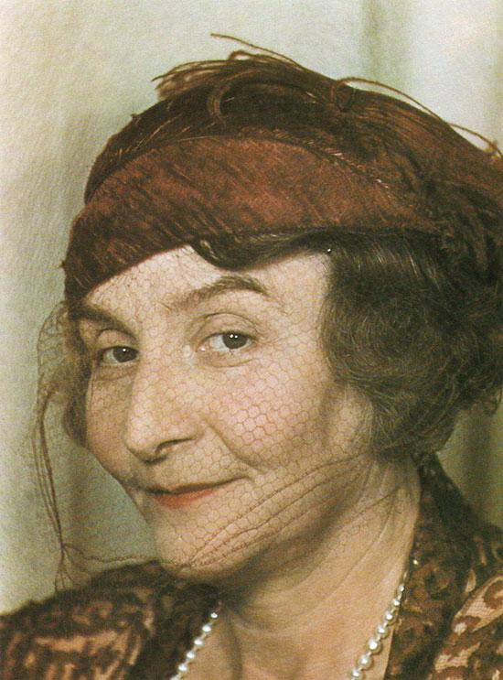
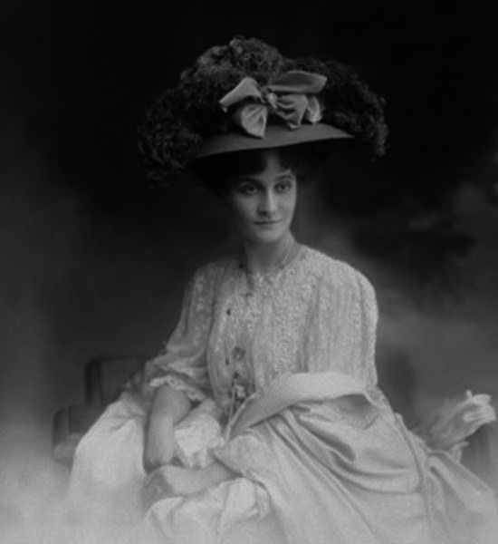
Marie Bonaparte (1882-1962)
Notes:
Met Freud in 1925
He had just started working on his paper, Inhibitions, Symptoms and Anxiety when she took to his couch for two hours every day for her analysis. He finished his paper and she wrote a research paper on “Considerations on Anatomical Causes of Female Frigidity.

Slide 24
Clinical Implications

Slide 25
Role of Mourning
Issues of body, how she feels about herself, her breasts, or hips, capacity to conceive
Quest for pleasure/organism
Hold a pregnancy

Slide 26
What Do Women Want to Talk about in Treatment
Infertility
Miscarriages,
Stillbirths
Children with medical needs or physical/neurological disabilities
Aging mothers with children of mental illness
Adult children who fail to thrive into adulthood

Slide 27
Freud’s Focus
Looked at women’s issues through the eyes of father
Women’s role in life is to stay at home
Be passive
Bear and raise children
Father is protector
Father is hostile figure who must be fought or submitted to

Slide 28
Loewalds Focus on Women
Focused on earliest relationship with mother
Integration is lifelong, not a static process
Revisiting earliest relationship with mother gives rise to spiritual feelings of awe, mystery
Focuses on the internal forces at play with the synthetic function of the ego
Focuses on mother/baby and early positive identification with father

Slide 29
Original Goal of Psychoanalysis
Freud’s analysis of the psychology of women took place not in a social or biological sphere- it took place within an analysis of patriarchy.

Slide 30
Contemporary Goal of Psychoanalysis regarding Feminity
Holding in one hand what we know about the analysis of patriarchy
Holding in another hand the maternal influences
Enter the tension (loewald) creating a potentially creative space between separation and closeness that is never fully resolved but gives rise to new life.

Slide 31
Our Human Brokenness gives rise to divinity. Hildegard Von Bingen (1098-1179)

Slide 32
